Slide 1
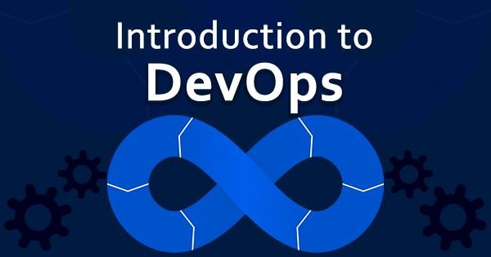


05-04-2025
Dr.S.Udhayakumar
Associate Professor, Department of Computer Science and Engineering (Cyber Security)
udhayakumars@wilp.bits-pilani.ac.in
BITS Pilani presentation
BITS Pilani
Pilani Campus
Faculty Name Faculty Department

Slide 2



05-04-2025
IMP Note to Students
It is important to know that just login to the session does not guarantee the attendance.
Once you join the session, continue till the end to consider you as present in the class.
IMPORTANTLY, you need to make the class more interactive by responding to Professors queries in the session.
Whenever Professor calls your number / name ,you need to respond, otherwise it will be considered as ABSENT

Slide 3
05-04-2025
Coverage
Software development lifecycle
The Waterfall approach
Agile Methodology
Operational Methodologies: ITIL
Development, Testing, Release, and Deployment Concepts
Provisioning, Version Control
Test Driven Development, Feature Driven Development
Behavior-driven development
BITS Pilani, Pilani Campus
Course Outline
 | Description
1 | Why and What is DevOps?
2 | DevOps Dimensions
3 | Source Code Management (Using GIT as an example tool)
4 | Continuous build and code quality
5 | Continuous Integration and Continuous Delivery
6 | Continuous Deployment
7 | Continuous Monitoring
8 | Configuration Management
9 | Virtualization and Containerization
BITS Pilani, Pilani Campus

Slide 4
05-04-2025
Self Study Labs
 | Self Study Lab Exercise
1 | Version Control using GIT, Creating repositories in GIT, Exercises to demonstrate the use of GIT operations and commands(Push, pull, clone etc.,) Creating branches and merging branches using GIT
2 | Installation of Jenkins and Configuration of Jenkins to work with different version control, build and testing tools
3 | Create jobs and projects in Jenkins
4 | Continuous integration with Jenkins through source code polling and build triggers
5 | Continuous inspection with Jenkins using sonarqube to ensure code quality
6 | Continuous deployment/delivery to staging/production environment with Jenkins.
BITS Pilani, Pilani Campus
Assignments
Skill Area | Activity | Activity
GIT | Install GIT | Create an account in github
Jenkins | Install Jenkins | Experiment with Jenkins as required in the Assignment.
Docker | Install Docker | Experiment with Docker as required in the Assignment.
BITS Pilani, Pilani Campus

Slide 5


05-04-2025
Evaluation of Assignment
BITS Pilani, Pilani Campus
Recorded Lectures for CS01
RL1.1 Foundational Terminology and Concepts
· RL1.1.1 Agile Methodology
· RL1.1.2 Operational Methodologies: ITIL
RL 1.2 Software Delivery
· RL2.1.1 Problems of Delivering Software
· RL 2.1.2 Principles of Software Delivery
BITS Pilani, Pilani Campus

Slide 6
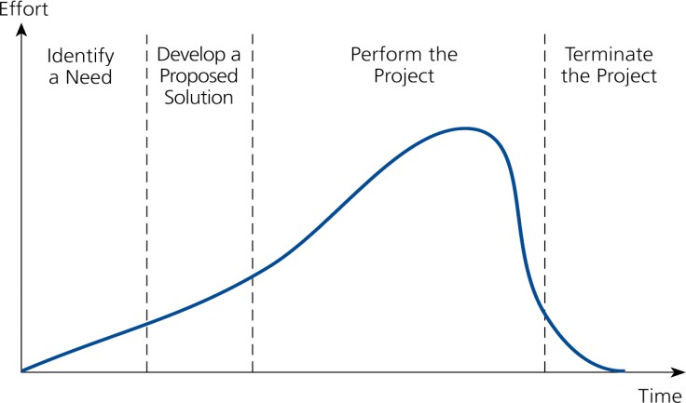
05-04-2025
Recorded Lectures for CS02
RL 1.3 About DevOps
· RL2.2.1 Need for DevOps
· RL2.2.2 Evolution of DevOps
· RL2.2.2 DevOps Practices
BITS Pilani, Pilani Campus
Typical Project Life-Cycle
(4 Phases)
Stages (Phases)
I
II
III
IV
BITS Pilani, Pilani Campus

Slide 7
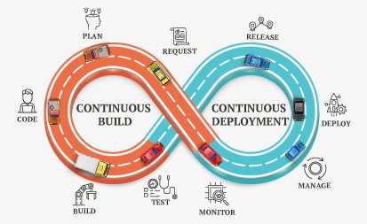


05-04-2025
Dr.S.Udhayakumar
Professor, Department of Computer Science and Engineering mailtoudhay@gmail.com
Course Objectives
No | Objective
CO1 | To learn the key ideas and techniques to bring development and operations together to produce higher-quality software and deliver it more quickly.
CO2 | To learn the core principles, business and technical terms used in DevOps from perspective of business and IT teams
CO3 | To gain knowledge of the Principles and practices of the DevOps Lifecycle including Continuous Integration, Continuous Inspection, Continuous delivery, Continuous deployment and Continuous monitoring.
CO4 | To understand the usage of tools and technologies used for implementing DevOps.

Slide 8
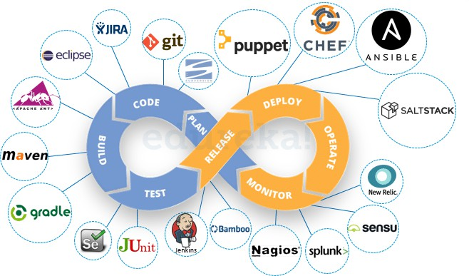
05-04-2025
Text books and References
No | Author(s), Title, Edition, Publishing House
T1 | DevOps: A Software Architect's Perspective (SEI Series in Software Engineering) by Len Bass, Ingo Weber, Liming Zhu , Publisher: Addison Wesley (18 May 2015).
T2 | Continuous Delivery: Reliable Software Releases through Build, Test, and Deployment Automation by Jez Humble, David Farley. Publisher: Addison Wesley, 2011
No | Author(s), Title, Edition, Publishing House
R1 | Effective DevOps: Building A Culture of Collaboration, Affinity, and Tooling at Scale by Jennifer Davis , Ryn Daniels. Publisher: O'Reilly Media, June 2016
R2 | The DevOPS Handbook: How to Create World-Class Agility, Reliability, and Security in Technology Organizations by Gene Kim, Patrick Debois, John Willis, Jez Humble, John Allspaw. Publisher: IT Revolution Press (October 6, 2016)
R3 | Web Resources: https://jenkins.io/ https://xebialabs.com/solutions/devops/ https://www.ibm.com/ibm/devops/us/en/casestudies/#all https://git-scm.com/ https://hub.docker.com/ https://www.atlassian.com/git/tutorials/comparing-workflows https://www.tutorialspoint.com/puppet/ https://www.tutorialspoint.com/chef/
Module 1 Why and What is DevOps?
RL1.1 Foundational
The Waterfall approach advantages and disadvantages
DevOps
Define the stages of a DevOps evolution
DevOps practices in organizations
The Continuous DevOps LifeCycle Process (Continuous Integration, Continuous Inspection, Continuous Deployment, Continuous Delivery, Continuous Monitoring)
Case Study- (IBM/Facebook/NetFlix)
Terminology and Concepts
RL1.1.1 Agile Methodology
RL1.1.2 Operational
Methodologies: ITIL
RL 1.2 Software Delivery
RL2.1.1 Problems of Delivering
Software
RL 2.1.2 Principles of Software
Delivery
RL 1.3 About DevOps
RL2.2.1 Need for DevOps
RL2.2.2 Evolution of DevOps
RL2.2.2 DevOps Practices

Slide 9
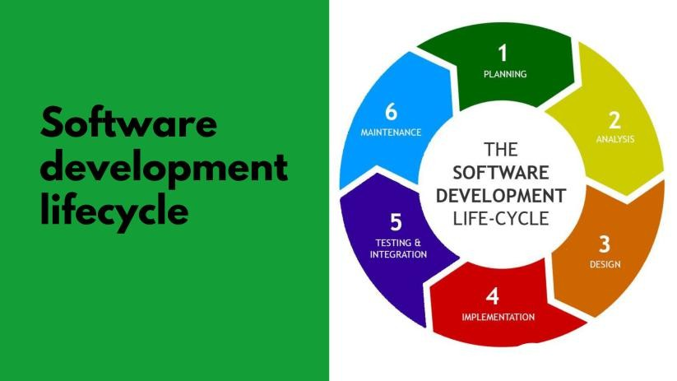
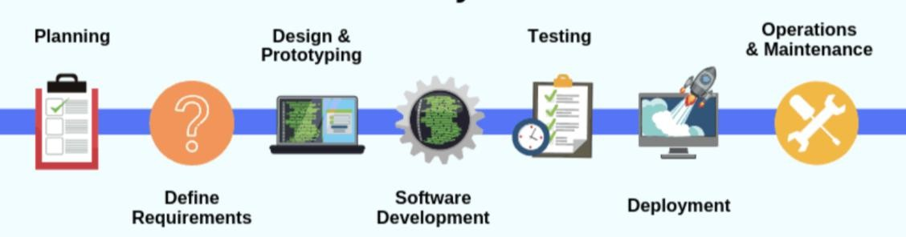
05-04-2025
Software Development Life Cycle (also called SDLC)
Software Development Life Cycle (SDLC) is a process used by the software industry to design, develop and test high-quality software’s.
The SDLC aims to produce high-quality software that meets or exceeds customer expectations, reaches completion within times and cost estimates.
System analysts can use it, designers and developers to plan and implement the applications and deliver the systems or products on time and within budget.

Slide 10
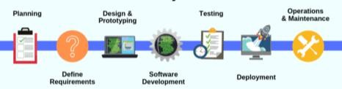
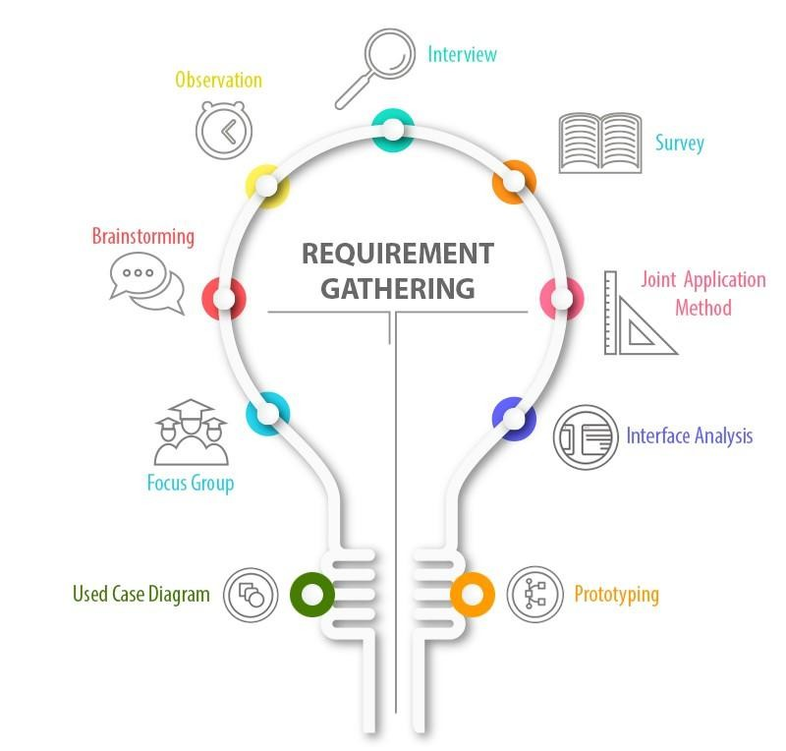
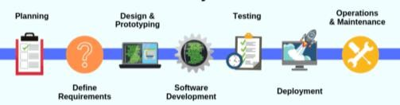
05-04-2025
Project Initiation
The high-level scope, problems and solutions are determined, and
planning is carried out accordingly for other stages.
Business Analyst Training
Other components that are to be considered in this stage are Resources, time/schedules, milestones, cost, business benefits and deadlines.
In the case of enhancements to existing projects, the strengths and weaknesses of the current software are studied, and the improvements are set as a goal, along with the collected requirements.
Business requirements are gathered. Meetings with project managers and stakeholders.
Identify
“Who will use the system”
“How the system should work “
“What should be the input & output of the system”
Analyze requirements for validity & incorporation of requirements Finally, prepare Requirement specification document

Slide 11
05-04-2025
Requirements Gathering
The requirements are of the type:
Functional Requirements
Non-functional Requirements
The end-user requirements from the customer and other stakeholders (salespeople, domain/industry experts, etc.) are collected.
Requirements are gathered using the following techniques:
By conducting Interviews
By conducting Workshops
By conducting Surveys and questionnaires
Focus Groups
Observations / time study
By conducting Brainstorming Sessions
Document Analysis (Ex: Regulatory
requirements)
Mind Mapping
Benchmarks
Analysis
The Analysis Phase is where you break down the deliverables in the high-level Project Charter into the more detailed business requirements.
A Software Requirement Specification (SRS) document is used in the analysis phase, which specifies the software, hardware, functional, and network requirements of the system is prepared at the end of this phase.
•
In this, every achievable requirement is anlyzed and documented as Software Requirements Specifications (SRS) or Functional Requirements Specifications (FRS).

Slide 12
05-04-2025
System Design
• This is the stage which stated, “How to achieve what is needed?”
• Software Requirements Specifications (SRS) are now transformed to the system design plan, which contains a detailed and complete set of specifications, commonly known as “Design Specification”.
• Prepare design of network, databases, application, system interfaces, user interfaces, system and software design from software requirement specification.
• •
All the technical details like technologies to use, project constraints, team’s
capability, etc. goes into the design specification document.
• The technical architects and developers develop the logical plan of the system which is then reviewed by all the stakeholders.
• Design a contingency, training, maintenance, and operation plan.
• At last, prepare a design document which will be used during next phases.
Development
When the design process of the software is over, the next step will be the coding. In this step, developers start constructing the whole framework using the programming language chosen to write code.
Tasks are divided into units or modules in the coding process and allocated to the specific developers. Coding is the enormous step of the SDLC.
Developers will obey specific predefined coding guidelines during this process.
They will also use programming tools such as compilers, interpreters,
debuggers to build and execute the code.

Slide 13
05-04-2025
Testing
When the coding is complete, testing begins, and the modules are released for
evaluation as software testing is necessary to avoid any bugs.
The created software is extensively reviewed during this process, and any issues found are assigned to developers to repair them.
Retesting and regression testing are conducted until the software is as planned by the expectation of consumers.
Testers refer to the SRS document to make sure the software conforms to the
customer’s standard.
Software Deployment
In this phase, the goal is to deploy the software to the manufacturing environment so that consumers can start using the product. Many companies, however, prefer to push the product across different delivery environments such as a testing or staging area.
It enables every stakeholder to play with the product safely before it is introduced into the market. Therefore, this allows us to catch any final mistakes before launching the product.

Slide 14
05-04-2025
Maintenance
When the software passes through all the stages without any complications, a maintenance cycle is to be performed in which it is updated and modified from time to time to adapt to changes.
Here are some benefits of SDLC are given below:
Using the SDLC it is easy to measure the growth and costs of the developed system
SDLC enhances the control and monitoring of the big or complex projects.
SDLC involves well detailed and comprehensive steps.
The design reviews help to ensure the reliability and quality of the developed
solution.
SDLC provides extensive documentation of the system.

Slide 15
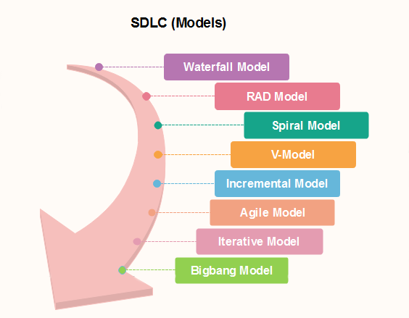
05-04-2025
Software Development Life Cycle
SDLC Phases
Requirement Analysis
Design
Development
Testing
Release
Feedback
Maintenance
SDLC Models

Slide 16
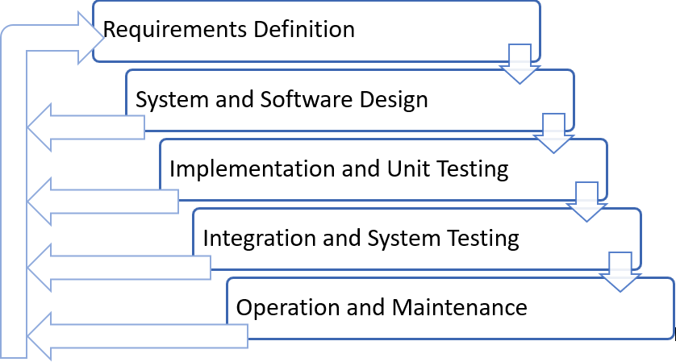
05-04-2025
Waterfall Model
Introduction
It is also called as the classic life cycle
Waterfall Model is considered as Black Box Model
One can not go back to previous phase
Sequential in Nature
This suggests a systematic, sequential approach to software development that begins with customer specification of requirements
And progresses through
Planning
Modeling
Construction
Deployment
and Culminating in ongoing support of the completed software
Waterfall Model Contd..
Feedback Amendment in Waterfall Model

Slide 17
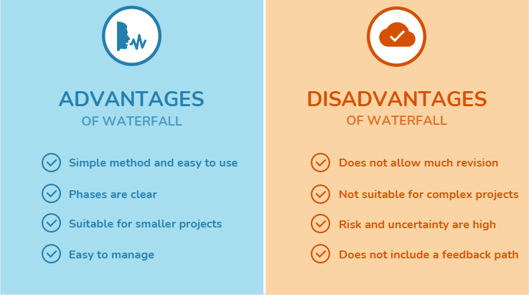
05-04-2025
Waterfall model pros and cons
Waterfall Model Contd..
Waterfall Model Strong Points
Easy to understand, easy to use
Provides structure to inexperienced staff
Milestones are well understood
Sets requirements stability
Good for management control (plan, staff, track)
Works well when quality is more important than cost or schedule
Limitation of the Waterfall Model
Not suitable for the project where requirements are
changing.
The high amount of risk and uncertainty
Not good for the object-oriented project
Poor model for long and ongoing project
Can give a false impression of progress
Integration is one big bang at the end
Little opportunity for the customer to preview the system

Slide 18
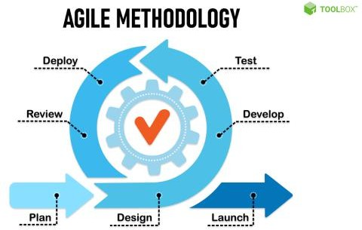
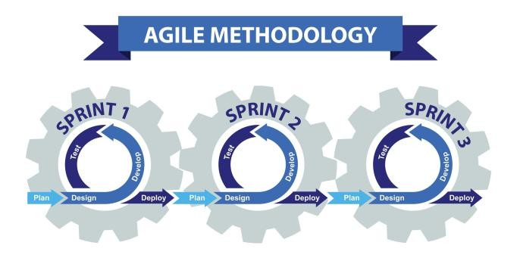
05-04-2025
Suitable Situation to use Waterfall Model
Work well for a small project
When Requirements are very well known
When Product definition is stable
When Technology is understood
When New version of an existing product
When Porting a current product to a new platform.
Agile Methodology

Slide 19
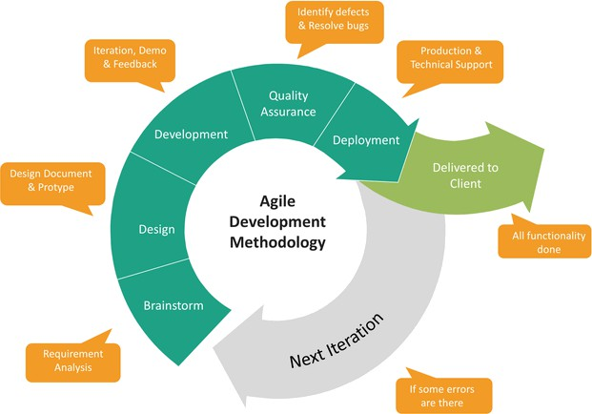
05-04-2025
Need of Agile
Why Agile?
The biggest problem with software development is changing requirements
Agile processes accept the reality of change versus the hunt for complete, rigid specifications
Speed up or bypass one or more life cycle phases
Usually less formal and reduced scope
Used for time-critical applications
Used in organizations that employ disciplined methods
Storm called Agile
According to VersionOne's State of Agile Report in 2017 says 94% of organizations practice Agile, and in 2018 it reported 97% organizations practice agile development methods

Slide 20




05-04-2025
Agile Methodology Contd..
Agile – Background
Agile was formally launched in 2001
17 technologists drafted the Agile Manifesto
Kent Beck | Mike Beedle |  | Arie van Bennekum |  | Alistair Cockburn |  | Ward Cunningham |  | Martin Fowler
James Grenning | Jim Highsmith |  | Andrew Hunt |  | Ron Jeffries |  | Jon Kern |  | Brian Marick
Robert C. Martin |  | Steve Mellor |  | Ken Schwaber |  | Jeff Sutherland |  | Dave Thomas
Agile Model Strong Points
It can adapt well with changing requirement
Deliver a working product faster than a conventional linear development model
Customer feedback at every stage ensures that the end deliverable satisfies their expectations
No guesswork between the development team and the customer, as there is face to face communication and continuous inputs from the client
Decrease the time required to avail some system features.
A test can be conducted during the design cycle
Fewer risks and has more flexibilities
Modification in the system needs less time
The result is high-quality software in the least possible time duration and satisfied customer.

Slide 21
05-04-2025
Agile Model Limitations
More Programmer centric than user-centric
For larger projects, it is difficult to judge the efforts and the time required for the project in the SDLC.
Since the requirements are ever-changing, there is hardly any emphasis, which is laid on designing and documentation. Therefore, chances of the project going off the track easily are much more
Scalability
The ability and collaboration of the customer to express user needs.
Documentation is done at later stages.
Reduce the usability of components.
Needs special skills for the team.
Principles of Agile Methodology
Twelve Principles
Our highest priority is to satisfy the customer through early and continuous delivery of valuable
software
Welcome changing requirements, even late in development. Agile processes harness change for the customer's competitive advantage
Deliver working software frequently, from a couple of weeks to a couple of months, with a preference to the shorter timescale
Business people and developers must work together daily throughout the project
Build projects around motivated individuals. Give them the environment and support they need, and trust them to get the job done
The most efficient and effective method of conveying information to and within a development team is face-to-face conversation
Working software is the primary measure of progress
Agile processes promote sustainable development. The sponsors, developers, and users should be
able to maintain a constant pace indefinitely
Continuous attention to technical excellence and good design enhances agility
Simplicity--the art of maximizing the amount of work not done--is essential
The best architectures, requirements, and designs emerge from self-organizing teams
At regular intervals, the team reflects on how to become more effective, then tunes and adjusts its behavior accordingly

Slide 22
05-04-2025
Pillars of Agile Methodology
Agile focuses on
Individuals and interactions
Processes and tools
Working software
Comprehensive
documentation
Customer Collaboration
Contract negotiation
Responding to change
Following a plan
Agile Methodologies
Few of Agile Methodologies
Scrum
Extreme Programming [XP]
Test driven Development [TDD]
Feature Driven Development [FDD]
Behavior-driven development [BDD]

Slide 23
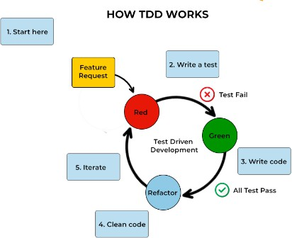
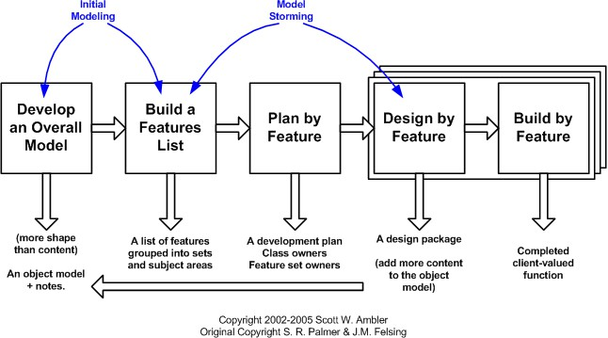
05-04-2025
Test Driven Development,
Feature Driven Development

Slide 24
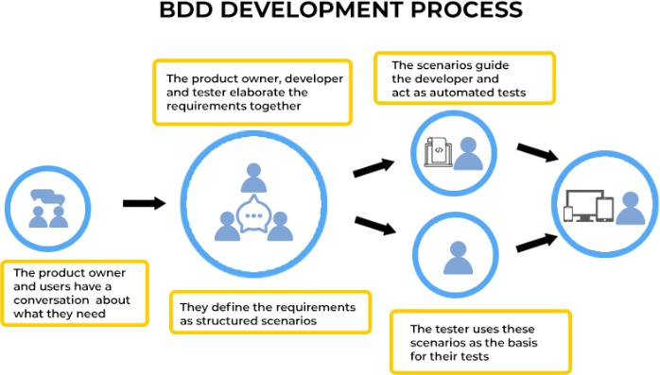
05-04-2025
Behavior-driven
development
Agenda
Operational Methodologies: ITIL
Introduction to Information Technology Infrastructure Library (ITIL)
IT Service Management (ITSM) Lifecycle
ITIL Framework

Slide 25
05-04-2025
Operational Methodology
ITIL
ITIL is a framework of best practices for delivering IT services
The ITIL processes within IT Service Management (ITSM) ensure that IT Services are provided in a focused, client-friendly and cost-optimized manner
ITIL’s systematic approach to IT service management can help businesses
Manage risk
Strengthen customer relations
Establish cost-effective practices
And build a stable IT environment
that allows for
Growth
Scale and
Change
ITIL
ITIL : Origin
Developed by the British government's Central Computer and Telecommunications Agency
(CCTA) during the 1980s
The ITIL first consisted of more than 30 books, developed and released over time, that codified best practices in information technology accumulated from many sources (including vendors' best practices) around the world
ITIL’s contribution aligned with the ISO/IEC 20000 Service Management standard in 2005
Since 2013, ITIL is owned by Axelos — a joint venture between the Cabinet Office and Capita

Slide 26
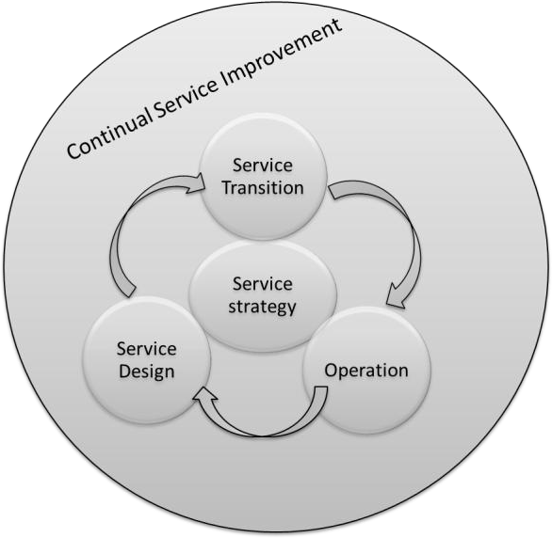
05-04-2025
ITIL
IT Service Management (ITSM) Lifecycle
ITIL views ITSM as a lifecycle
Five Phases:
Service Strategy [design, development, and implementation]
Service Design [design and
development]
Service Transition [development and design]
Service Operation [delivery and support]
Service Improvement [create and maintain value]
ITIL Framework
Service
Strategy
Service
Design
Service Transition
Service Operation
CSI
Demand
Management
Service level
Management
Transition Planning and support
Event Management
Service portfolio Management
Supplier Management
Change Management
Incident Management
Financial Management
Capacity Management
Asset and Configuration management
Problem Management
Business Relationship management
Availability management
Service validation and testing
Request Fulfilment
Release and Deployment Management
Access Management
Continuity
Management
Evaluation
Service Desk
Information Security Management
Knowledge Management
Technical Management
Service catalogue Management
Application Management
Design Coordination
IT Operations

Slide 27
05-04-2025
ITIL
ITIL: Is a Project?
ITIL is not a “Project”
ITIL is ongoing journey
Benefits of ITIL:
Organizations to reduce the operations cost by optimizing the available resource utilizations
Reduce system outages and minimize the impacts of service unavailability
Even most organizations testified with reduction in business critical incidents by 80 to 90% in few years
Agenda
Problems of Delivering Software
Problems of Delivering Software
Release Antipatterns
Principles of Software Delivery

Slide 28
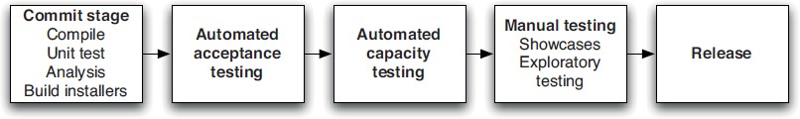
05-04-2025
Problems of Delivering Software
Converting Idea to Product / Service?
Reliable, rapid, low-risk software releases
Ideal Environment
Generic Methodologies for Software Methodologies
More focus on Requirement Gathering
Problems of Delivering Software
Release Antipatterns
Common Quote “The day of a software release tends to be a tense one”
Antipattern: Deploying Software Manually
The production of extensive and detailed documentation for steps to be performed
Reliance on manual testing
Frequent calls to the development team to explain
Frequent corrections to the release process
Sitting bleary-eyed in front of a monitor at 2 A.M

Slide 29
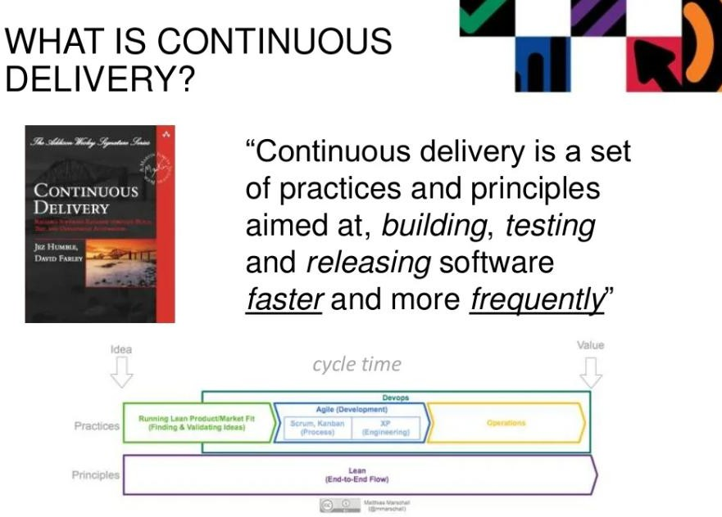
05-04-2025
Problems of Delivering Software
Release Antipatterns Cond..
Antipattern: Deploying to a Production-like Environment Only after Development Is Complete
Tester tested the system on development machines
Releasing into staging is the first time that operations people interact with the new release
Who Assembles? The Development Team
Collaboration between development and Operations?
Antipattern: Manual Configuration Management of Production Environments
Difference in Deployment to Stage and Production
Different host behave differently
Long time to prepare an environment
Cannot step back to an earlier configuration of a system
Modification to Configuration Directly

Slide 30
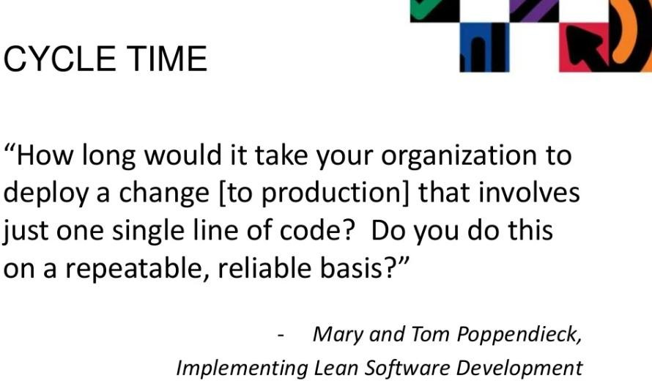
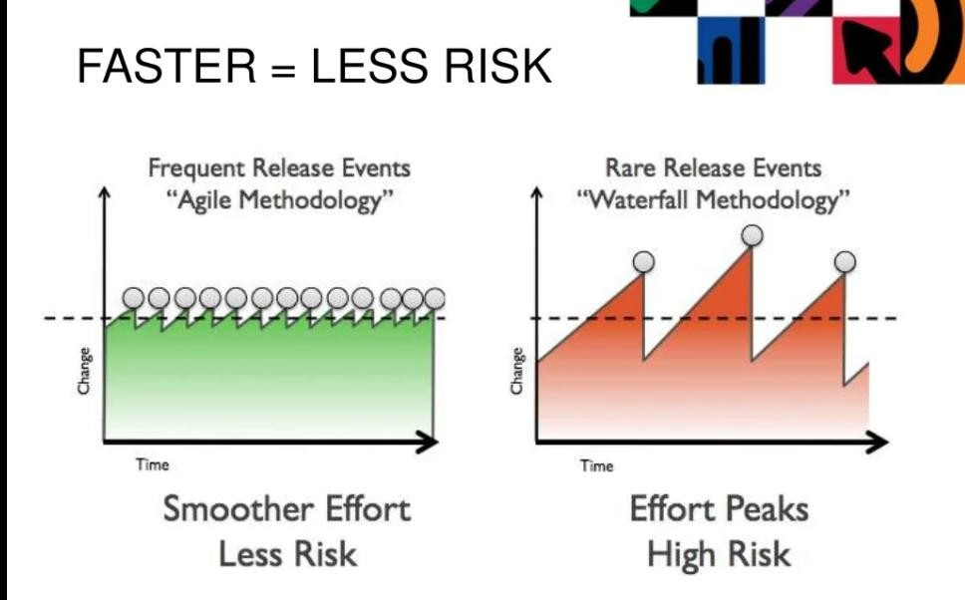
05-04-2025

Slide 31
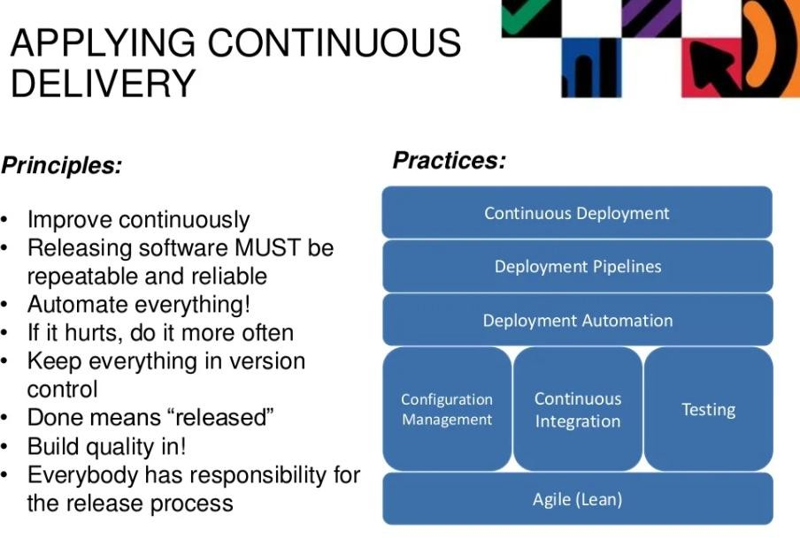
05-04-2025
Continuous Delivery
Introduction to Continuous Delivery
Promotes the adoption of an automated deployment pipeline to release software into production
reliably and quickly
Its goal is to establish an optimized end-to-end process, enhance the development to production cycles, lower the risk of release problems and provide a quicker time to market
To that point, Jez Humble and Dave Farley define the 8 principles of continuous delivery in their Book “Continuous Delivery” as:

Slide 32
05-04-2025
Principle of Continuous Delivery
Build Repeatable and Reliable Process
Use the same release process in all environments
If a feature or enhancement has to work through one process on its way into the integration environment, and another process into QA, issues find a way of popping up
Principle of Continuous Delivery
Try to Automate Everything
Automate builds, testing, releases, configuration changes and everything else
Manual processes are inherently less repeatable, more prone to error and less efficient
Once we automate a process, less effort is needed to run it and monitor its progress – and it will ensure to have consistent results

Slide 33
05-04-2025
Principle of Continuous Delivery
Keep everything in Version Control
Have one source of truth
Keep Code, configuration, scripts, databases, documentation and everything versioned
Principle of Continuous Delivery
Bring the Pain Forward
Deal with the hard stuff first
Time-consuming or error prone tasks should be dealt with as soon as you can
Once you get the painful issues out of the way, the rest will most likely be easier to perfect

Slide 34
05-04-2025
Principle of Continuous Delivery
Ensure Quality – in Build
Create short feedback loops to deal with bugs as soon as they are created
By having issues looped back to developers as soon as they fail post-build test, it will enable them to produce higher quality code quicker
In addition, fewer issues will be found later on in the process, when it will be more expensive to
fix
Principle of Continuous Delivery
Set expectation as "Done" means Released
A feature is done only when it is in production
Having a clear definition of “done” right from the start will help everyone communicate better, and realize the value in each feature

Slide 35
05-04-2025
Principle of Continuous Delivery
Everyone is Responsible
"It works on my workstation" is never a valid excuse
Responsibility should extend all the way to production
Cultural change can be the hardest to implement
However, having management support and an enthusiastic champion will certainly help
Principle of Continuous Delivery
Continuous Improvement
This principle is the most important for effective automation
If "practice makes perfect" then automation represents the ultimate expression of a practice- making-perfect iterative process.

Slide 36
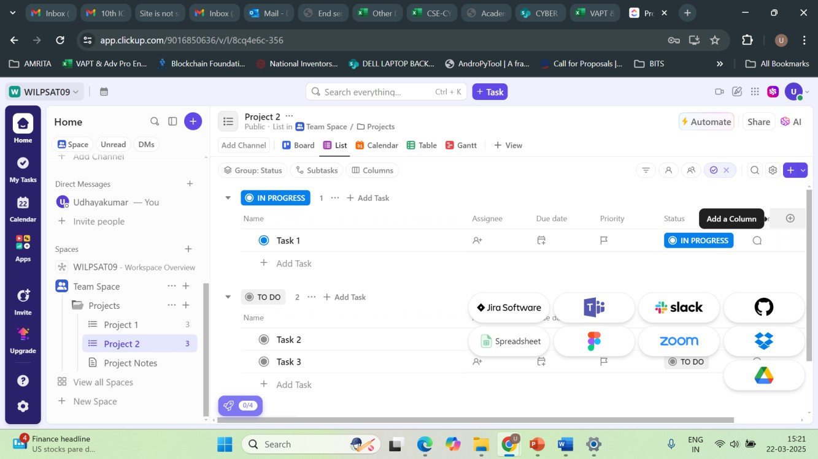
05-04-2025
Principle of Continuous Delivery
Summary
Create a Repeatable, Reliable Process for Releasing Software
Automate Almost Everything
Keep Everything in Version Control
If It Hurts, Do It More Frequently, and Bring the Pain Forward
Build Quality In
“The Earlier you catch the defects, the cheaper they are to fix”
Done, Means Released
Everybody Is Responsible for the Delivery Process
Continuous Improvement

Slide 37
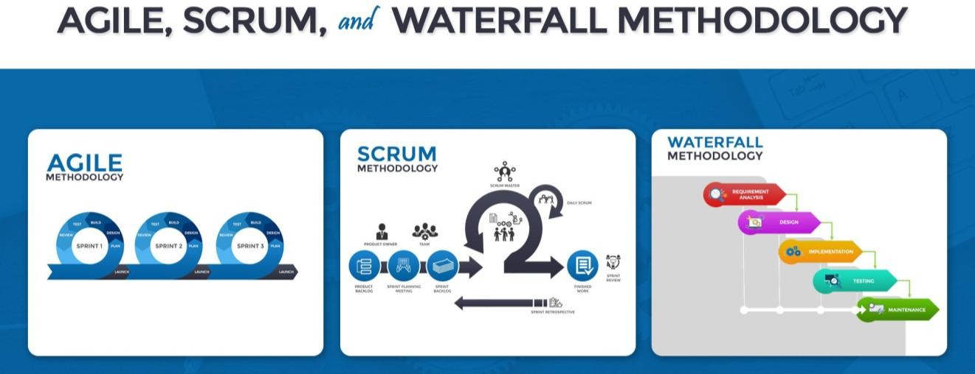
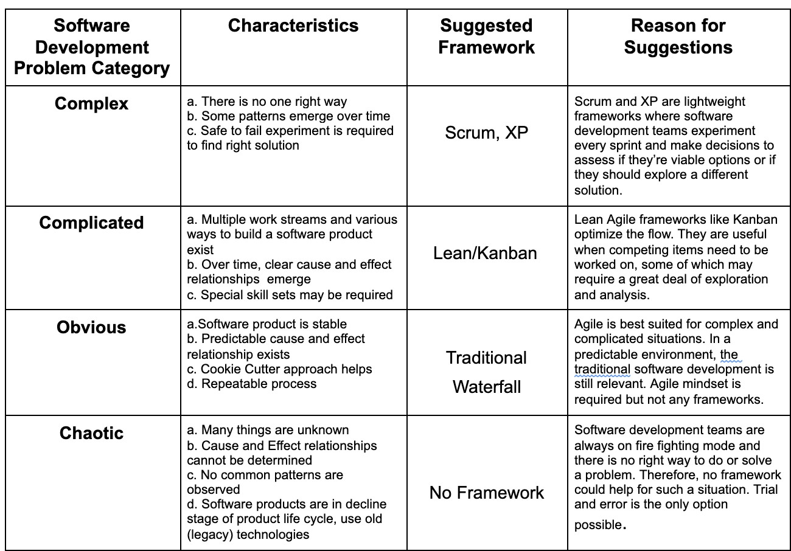
05-04-2025

